Slide 1
Livestock Trail Length Over Time
Ryan Olsen ES751 Advanced GIS
10 May 2023

Slide 2
Topics
Purpose
Methods
Results

Slide 3
Purpose
First attempt:
Can publicly available LIDAR be used to detect changes in local drainage patterns due to trails made by cattle or other herd animals?

Slide 4
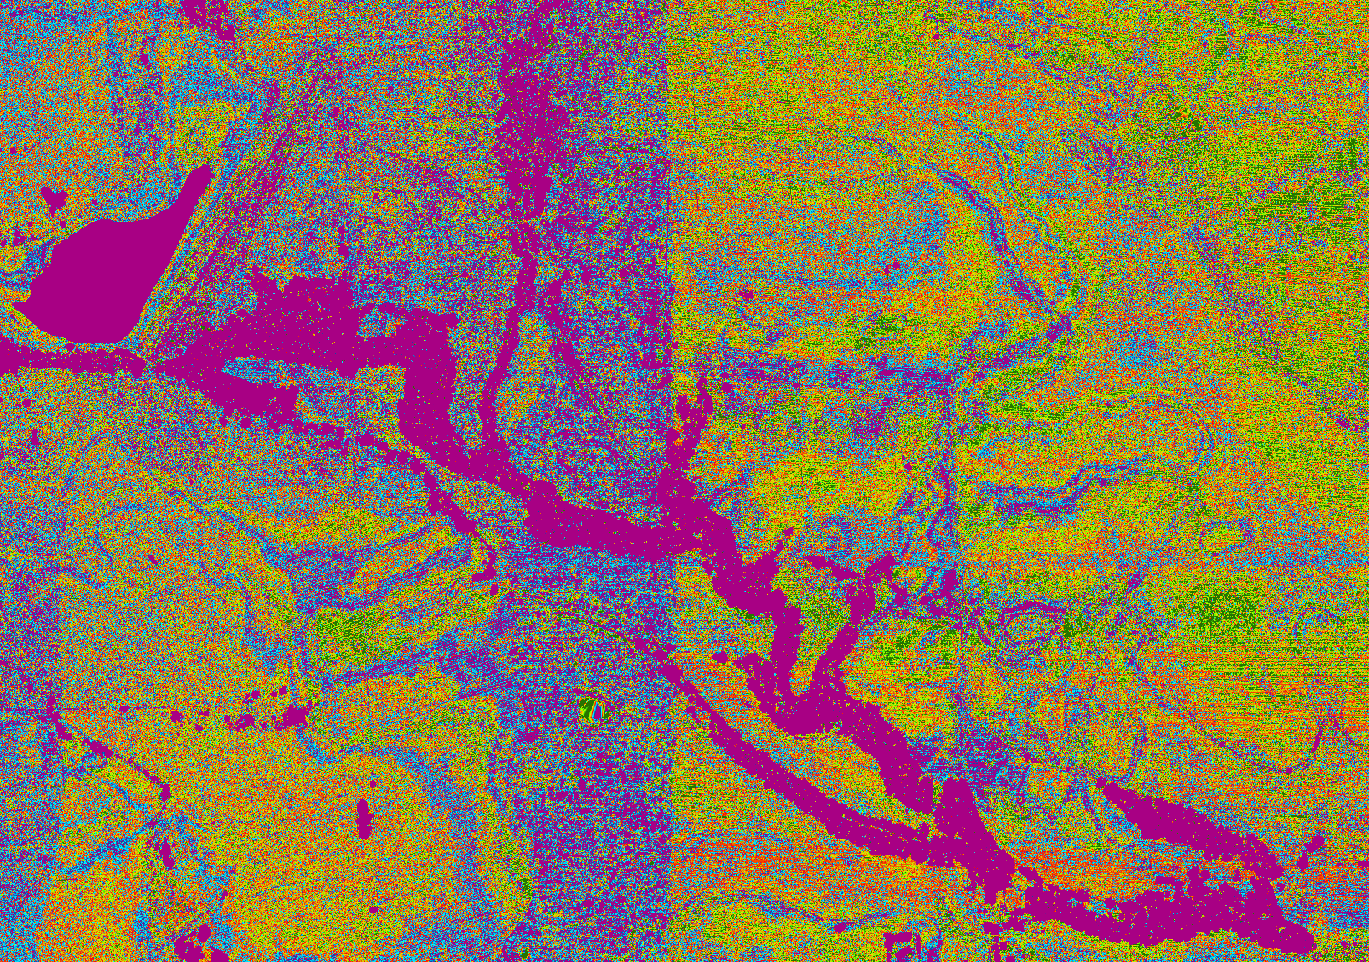

Slide 5
Purpose
Second attempt:
Can publicly available LIDAR or other imagery be used to find animal trails at all?

Slide 6
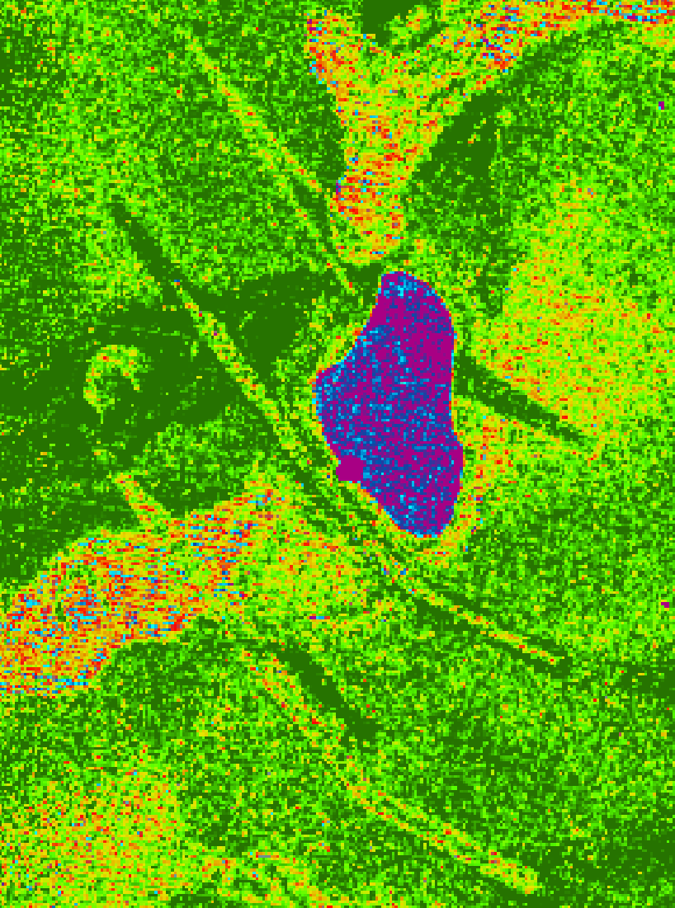
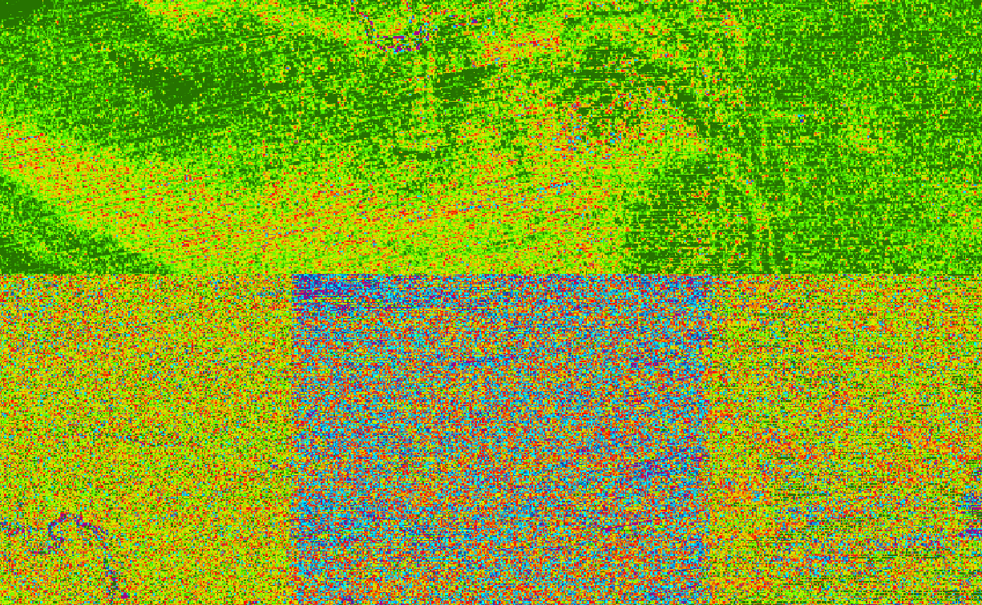
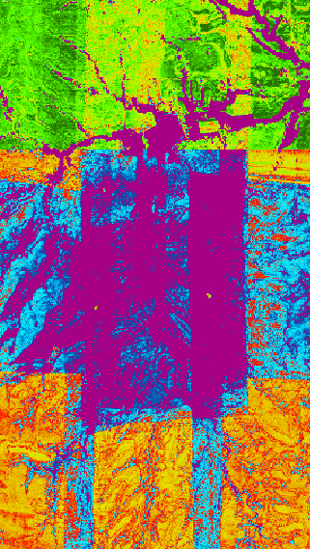
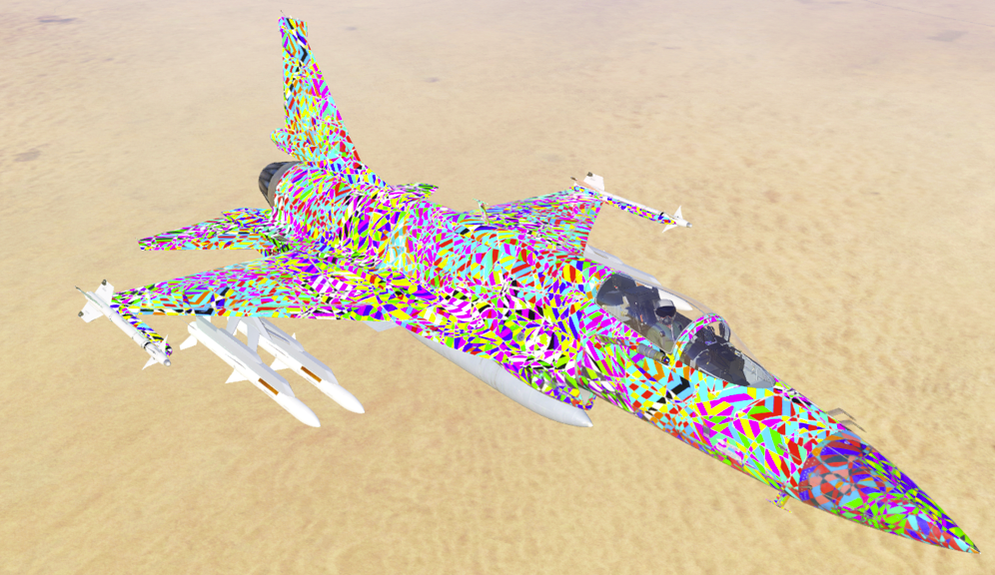
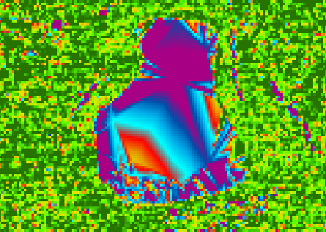
Overlaps and averaged returns
Eye cancer airplanes
Echoes of a pond dam, only the middle one is real
Interpolation artifacts
Obvious mismatch in LIDAR returns

Slide 7
NO.
Current publicly available LIDAR does not have a high enough resolution, is too noisy, and has too many artifacts to be useful for this purpose.

Slide 8
Purpose
Fourth attempt:
Using publicly available imagery (not LIDAR) can differences in trails of cattle and wild horses be quantified?

Slide 9
Methods
Imagery obtained from DASC.
Confine area of study:
A pasture was chosen that have similar terrain for each species, one that only had cattle and one that had cattle then was switched to wild horses over the period studied.
A quarter section was chosen out of each pasture for digitization.
Digitize:
Only trails that could be seen at 1:500 scale or smaller were digitized.
Trails that remained parallel from point to point, roads, and stream beds were not digitized.
Add trail lengths and compare.

Slide 10
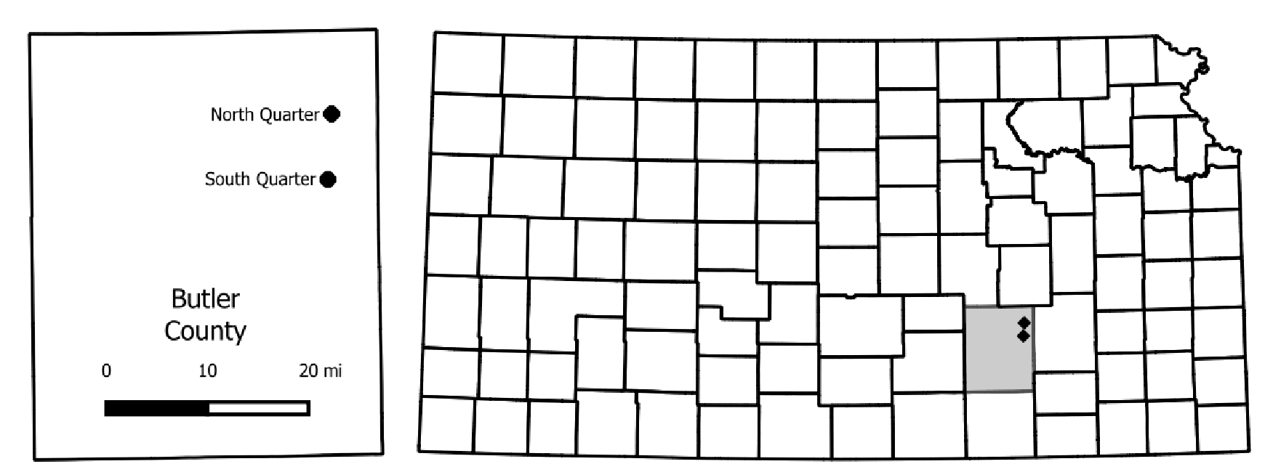

Slide 11
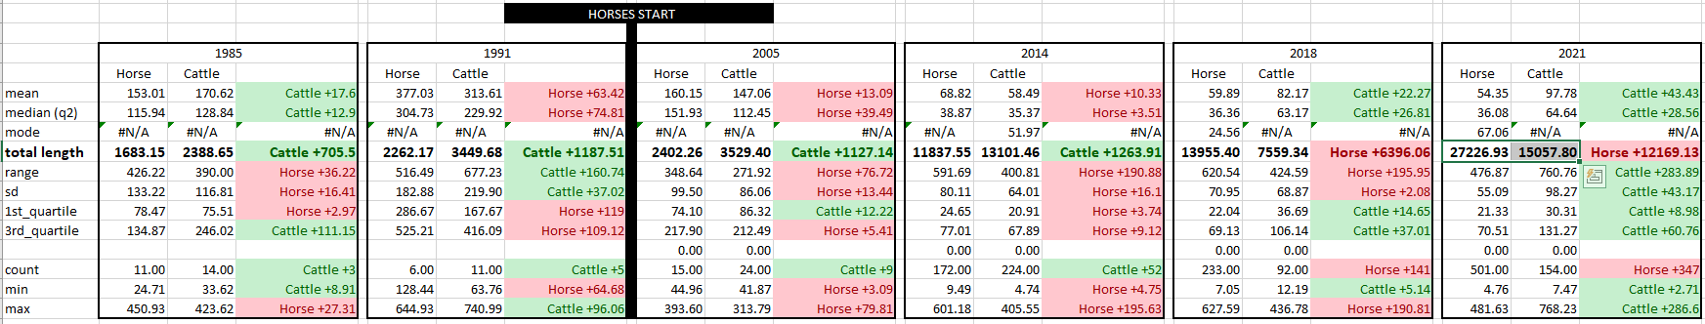
Result
There are differences in the total trail lengths between wild horses and cattle when comparing equal resolution imagery.
The total length of horse trails is increasing faster than cattle trails cattle when comparing equal resolution imagery.

Slide 12
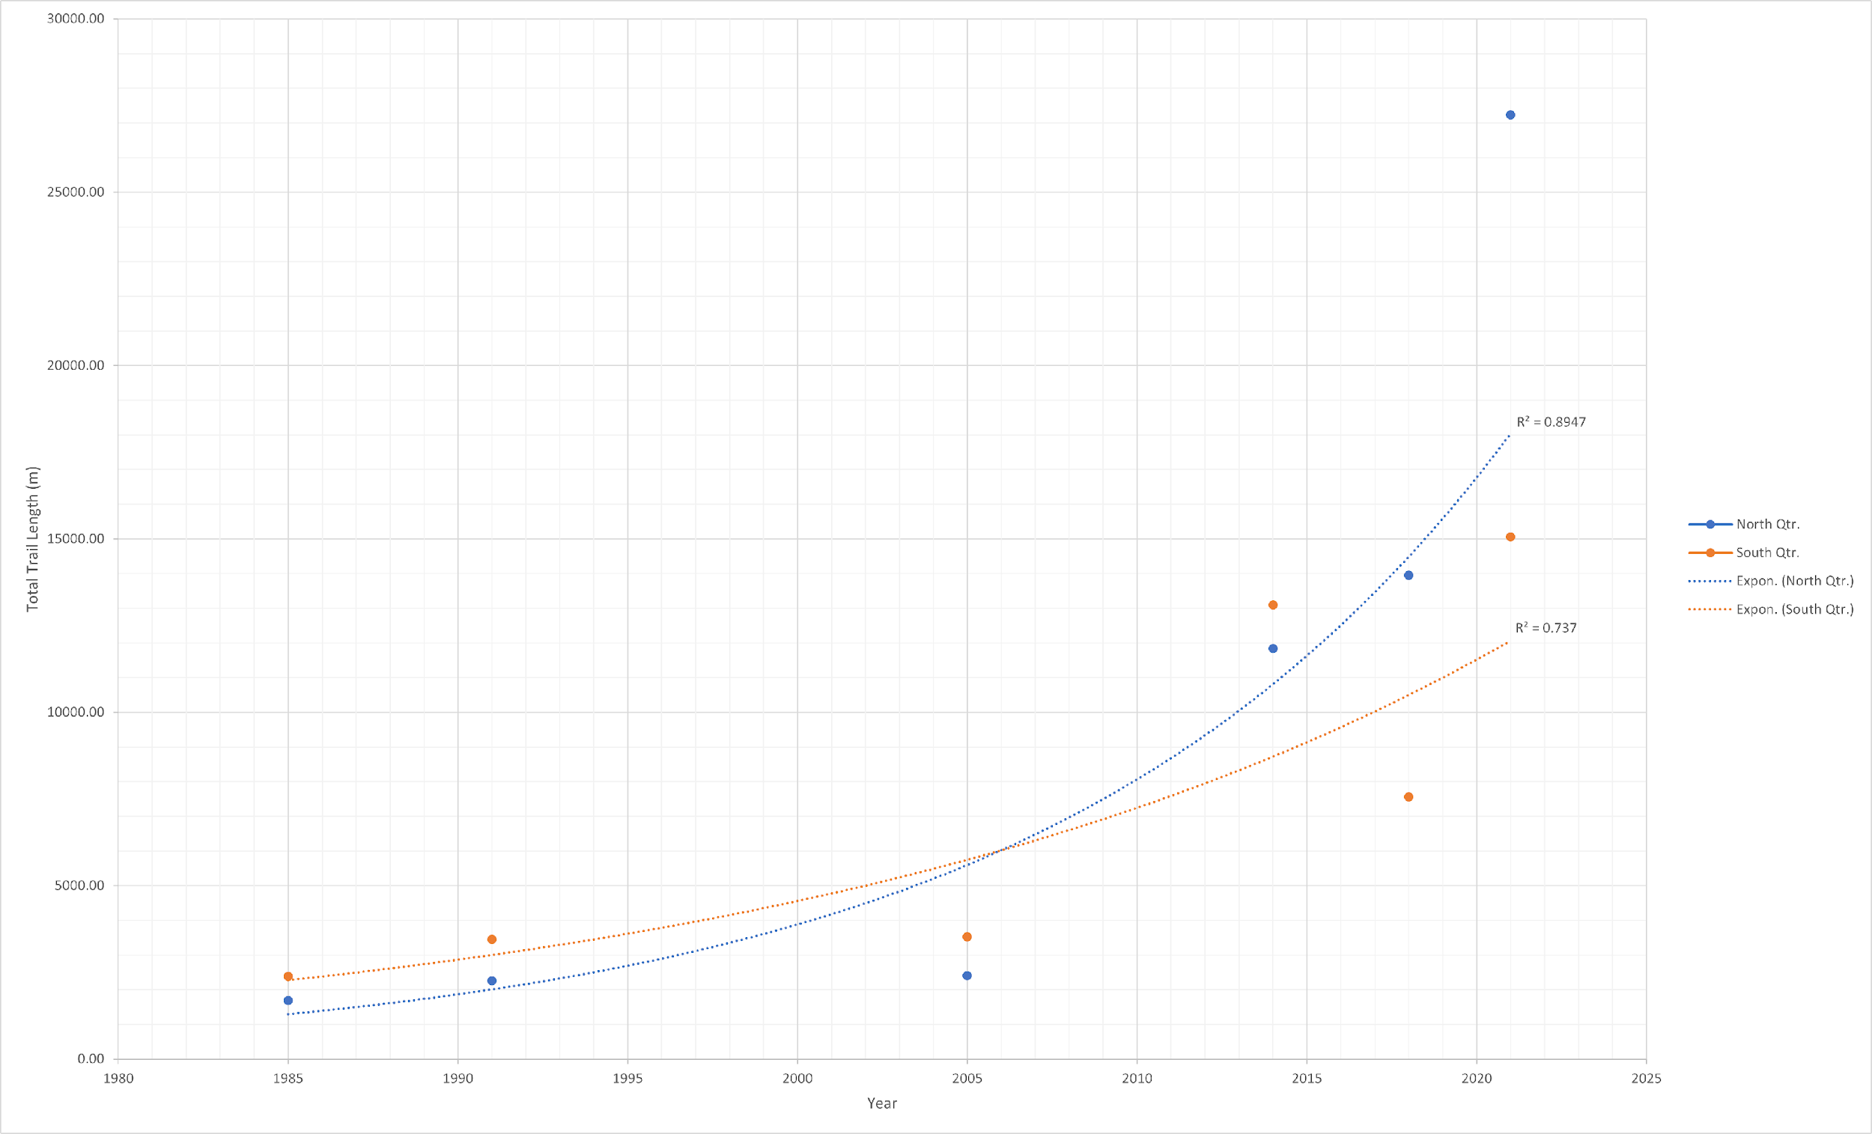
Livestock Trail Length Over Time
The cattle pasture was burned in 2021
2018 was a severe drought year
Approximate introduction of wild horses

Slide 13
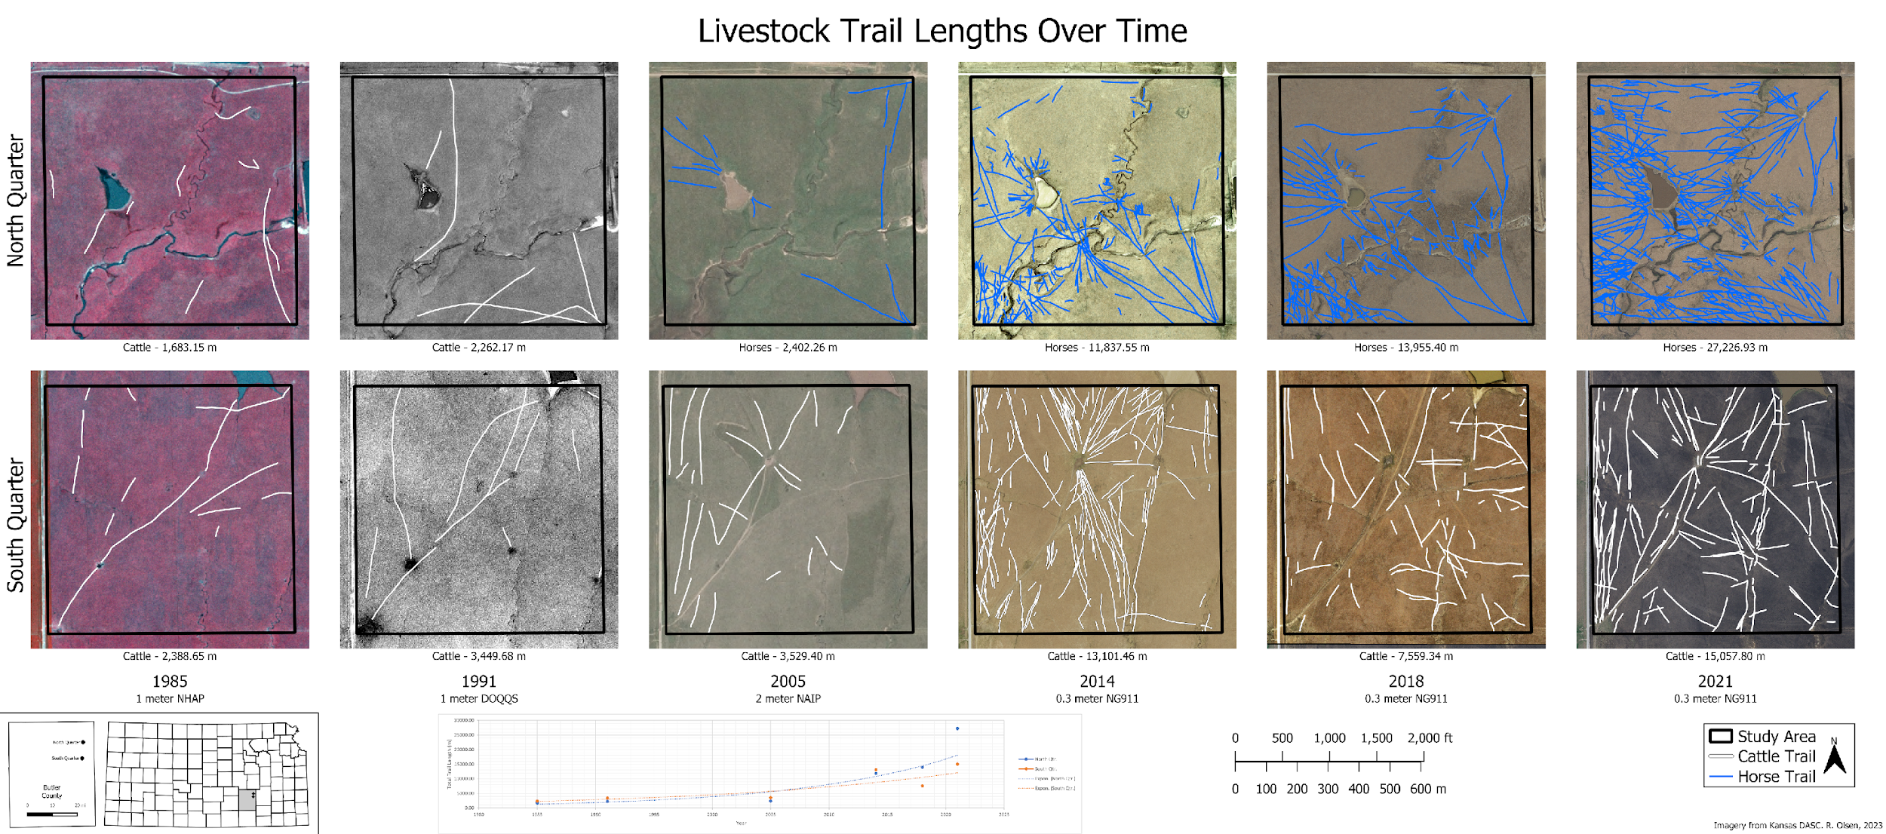

Slide 15
Result: Potential causes
Modern wild horses are not native to this area.
Wild horses are not rotated to other pastures as often as cattle.
Wild horses appear to make new trails more often than reusing old ones.
Difference in how wild horse are managed versus cattle.

Slide 16
Result: Cosmic Significance
There are noticeable changes in the total livestock trail lengths over a 36-year period for the areas studied that could mean that wild horses could potentially contribute to prairie habitat or pasture destruction.

Slide 17
Result: Further Research?
Short term:
Expand area of interest
Compare changes for different types terrain
Long Term:
Use drones to make high resolution maps of a full pasture on a regular basis.
Track individual animals for a long period of time.

Slide 18
Topics, again
Purpose
Failed attempt #1
Failed attempt #2
Failed attempt #3
Attempt #4 – not a failure
Methods
Trace animal trails and add them together.
Results
There is a detectable change in total trail lengths.
Wild horse potentially cause more damage to the land through creation of multiple trails.

